Slide 1


Determining ongoing investment and approach to tackle mental health stigma and discrimination beyond 2026
Wendy Halliday
Director See Me

Slide 2

Our vision: A fairer, more inclusive Scotland, free from mental health stigma & discrimination (2021-2026)
How, and what do we need to do differently?
‘Universal’ vs Targeted
Siloed vs Intersectional
The need for an alternative frame to understand and redress injustice.

Slide 3
2002 - 2013
National campaign
2013-2016
Re-founding
2016-2021
Complex multi layered programme
Foundational / Core
2021 - 2026
Structural , cultural, institutional and person stigma
Targeted to ppl who exp. Greater risk of S and D and inequalities
Trauma informed LE contribution and leadership
Community Dev
Media / Social
Targeted Campaigns
Social movement
Behaviour change
Settings based programmes in influence system wide change
Lived experience social contact
Social Marketing
Media targeted
Campaigning
Social movement
Understanding
Behaviour change
Settings based change programmes
Social Marketing
Comms and media
LE volunteers
Awareness
Understanding
Social Marketing
Campaigning
Communications
LE voices
Employer pledges
Continuous improvement
Arts and creativity
Evolution of See Me
Data , evidence base, research, knowledge and evaluation
National hub

Slide 4
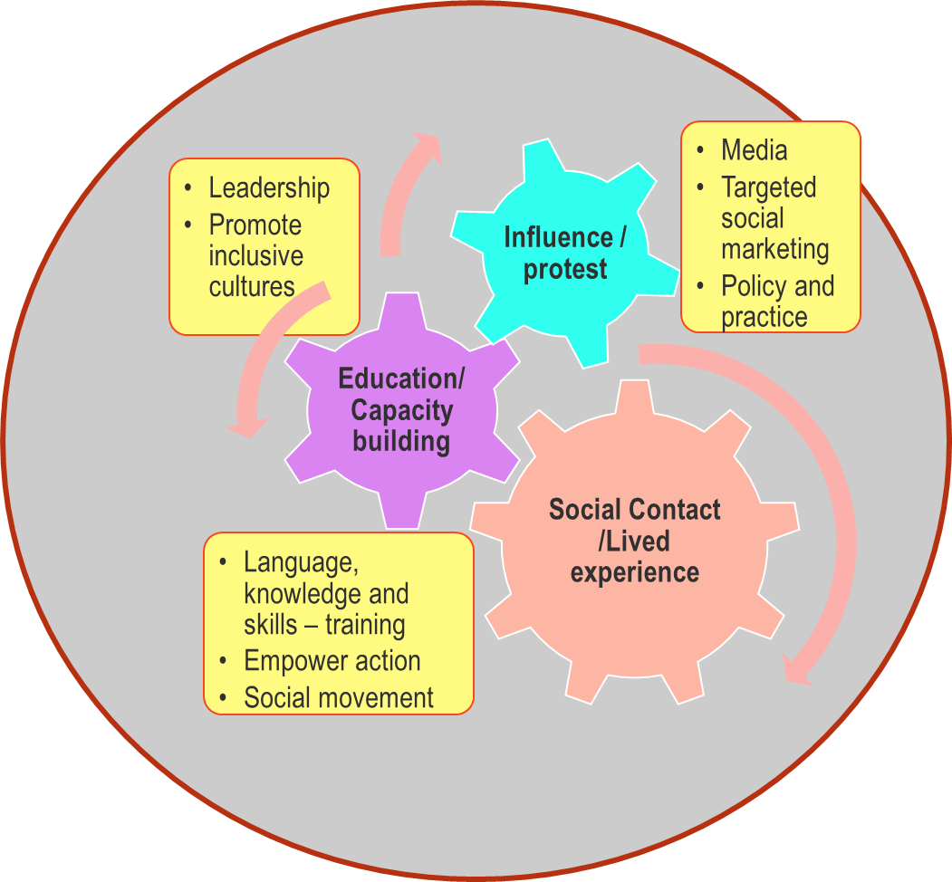
Global Anti stigma Mental health evidence base
Community development
Improvement methodology (structural/system)
Comms, campaigns, policy and public affairs
Universal & targeted (i.e. priority groups, settings)
Focus on addressing the discrimination that leads to inequity / inequality for people living with mental illness

Slide 5
We’ve taken a programmatic approach…
Settings
Health and social care
Mental Health Services
Education and YP
Employment workplace
Community and Priority groups
Capacity building
Community champions
Local approaches
Intersectional partnerships
Arts fund Creativity
Comms, policy and public affairs
Campaigns
Policy
Public affairs
Website
Social media
Media
Social movement
Lived experience participation
See Me volunteers
Lived experience leadership
Youth consultants
Data, Research , Knowledge exchange , monitoring and evaluation

Slide 6

Approach in settings
Mainstreaming - MH workplace, schools, FE , HE
Quality ambitions – Legal and policy levers
Creating conditions for inclusion:
Leadership buy in / co-ordination / role modelling
Intrinsic within commissioning, strategy, planning, quality and improvement processes
Inclusive (micro) cultures and ethos – language, policy and practice implementation, peer-led approaches
Safe environment - safe disclosure and response
Education training and capacity building – social contact
Practice change – inclusive, experience-led
Individualised – ‘with’ not ‘for’…
Accountability – measurement, data collection, impact

Slide 7
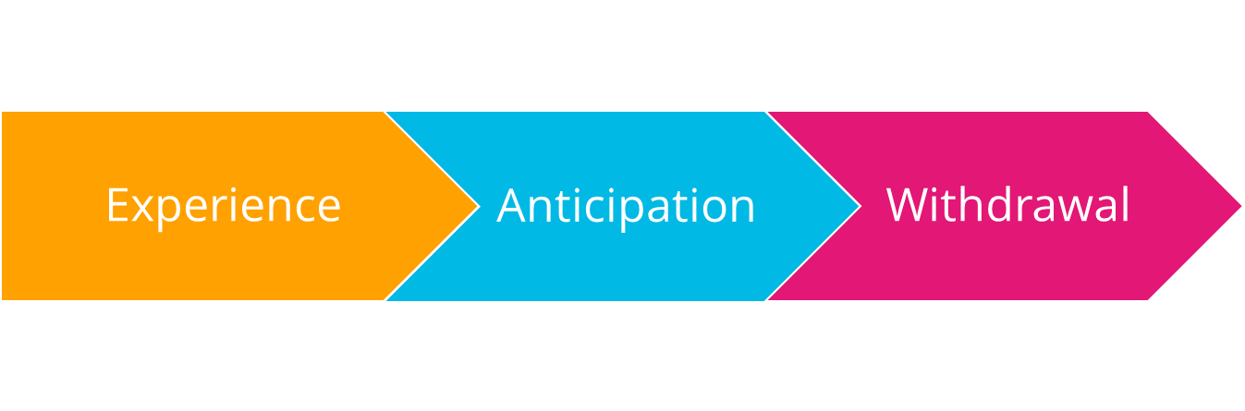
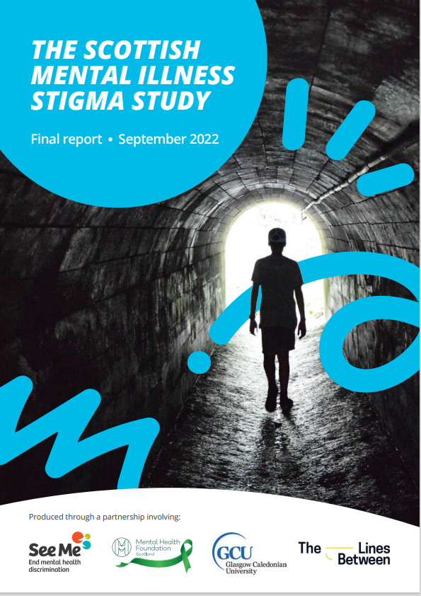
2022: The Scottish Mental Illness Stigma Study…
Additional Data Collection
Collation of individual and community data on stigma and discrimination experienced by people who are racialised and marginalised – nature scale and impact
Community anti stigma arts fund
Creative methodologies
Community development
Research and Literature review

Slide 8

Definitions
Stigma - a social process that involves the damaging labelling, stereotyping, and exclusion of individuals or groups based on perceived differences that deviate from dominant social norms.
Discrimination - a key part of stigma. It is the inequitable or prejudicial treatment of individuals or groups based on their stigmatised identities. It can be intentional (explicit prejudice) and unintentional (underlying in organisations and systems).
Intersectional stigma - multiple forms of stigma mutually shape the lived experiences and opportunities of groups who are marginalised, and create distinct disadvantages, which cannot be understood in isolation from one another.

Slide 9

Stigma is a social process that benefits those with greater levels of privilege and power
It keeps people “in”, enforcing preferred social norms and values,
It keeps people “down”, maintains group advantage in society,
It keeps people “away”, avoid “disease” or a perceived threat.
People who experience stigma describe being categorised or treated differently ‘us and them', 'have / have not’, or ‘can or cannot’
Mental health stigma and discrimination is rarely experienced in isolation, people have multiple identities, life circumstances and behaviours all of which can be subjected to negative stereotypes, stigmatisation, discrimination and social exclusion.

Slide 10
Key Challenges
People experiencing severe and complex mental illness; people who are racialised or marginalised; or experience distress and crisis face higher levels of stigma and discrimination, leading to poorer quality of life and early mortality
A person’s experience of stigma and discrimination is complex and unique - influenced by identity, behaviour-based and other health stigmas
Most anti-stigma initiatives operate in silos - many people describe being excluded and falling through the net
Universal approaches to addressing mental health stigma and discrimination are the norm and further exacerbate inequalities for marginalised and racialised groups
Legislative and policy protections are not implemented adequately, they lack provision for ‘dual discrimination’ leading to lack of intersectional data, and accountability is poor
Intersectionality and intersectional stigma are poorly understood and applied across policy and practice – resistance, lack of confidence, capacity and skills

Slide 11
Why See Me adopted an intersectional approach:
Increased stigma and discrimination (incl MH) in communities and services
People describing overlapping stigma, in services across the system, creating inequity of access, experience and outcomes.
People want human, compassionate responses that take account of the complexity of their lives.
Focus on personal/interpersonal stigma within the family, community or other settings.
Focus on system & cultural change, working to combat structural factors that lead to marginalisation, inequity and inequality
MWC – See Me to focus on S and D exp. by racialised and other minorities communities
Take account of different forms of stigma and discrimination (e.g., mentalism, racism, ablism, homophobia...) individuals and groups face to improve outcomes
Advance mental health equity and our response the Public Sector Equality Duty for people experiencing mental health stigma and discrimination
Focus on access/ inclusion for people and groups at the greatest risk of intersectional mental health stigma in the programmes policies, practices and culture.
Be transparent about our intentions and progress and position See Me at the forefront of progressive mental health equity work.

Slide 12
Tackling stigma requires a system-wide approach
We have adapted evidence and understandings from Karla's work on prejudice and discriminatory social processes using the SCIP Framework (Pérez Portilla 2016;)
Political ideologies, policies, and legislation determine the societal conditions that constrain or enable our access to opportunities, resources, and wellbeing.
^{intersecting}
Structural Level
Damaging ideologies, social norms, and labelling influence interpersonal stigma, discrimination and exclusion in our interactions with other people.
Cultural/
Societal Level
Institutional
Level
Opportunities and resources that determine our wellbeing are established and formalised within institutional and organisational systems in policies and practices.
Personal Level
People with stigmatised identities, mental health conditions and/or coping mechanisms internalise negative societal beliefs about themselves.

Slide 13

Intersectional stigma reduction intervention principles
Recognise and name how systems of power intersect to affect individual experiences and fuel stigma
Aim to dismantle systems of power and oppression, and mitigate the harms
Ensure community leadership and meaningful engagement
Support collective action, cohesion, and resistance to address intersecting inequities

Slide 14
Benefits of an intersectional approach
make the invisible visible – ‘mainstream’ bias, power, privilege, oppression.
point at structural changes needed and highlight social movements and social contact are central to key changes. ​
highlight that inclusion and belonging must be by design – exclusion has been by default due to historic exclusion.
invite us to critically reflect on our role in upholding or countering the status quo at all levels through policies, practices and culture
steer away from emphasising deficit and vulnerability – highlight community strength, resilience and resistance/collective action.
platform marginalised voices and ideas, listen, imagine and co-create radically different futures – creativity helps!

Slide 15


Our developing approach...
Research to understand the historical influence and legacy - where it comes from, what purpose it serves today, how it is upheld and what we can do to address it.
Collaborate to act on the Scottish Mental Illness Stigma Study
Drive action based on the Expert Group Report
Drive action at four levels (SCIP) to influence system wide change
More deliberative and targeted in policy and PA
Targeted communications and campaigns
Prioritising key settings (SMISS)
Lived experience led – centring voices and expertise
Partnerships – community development
Arts and creativity

Slide 16
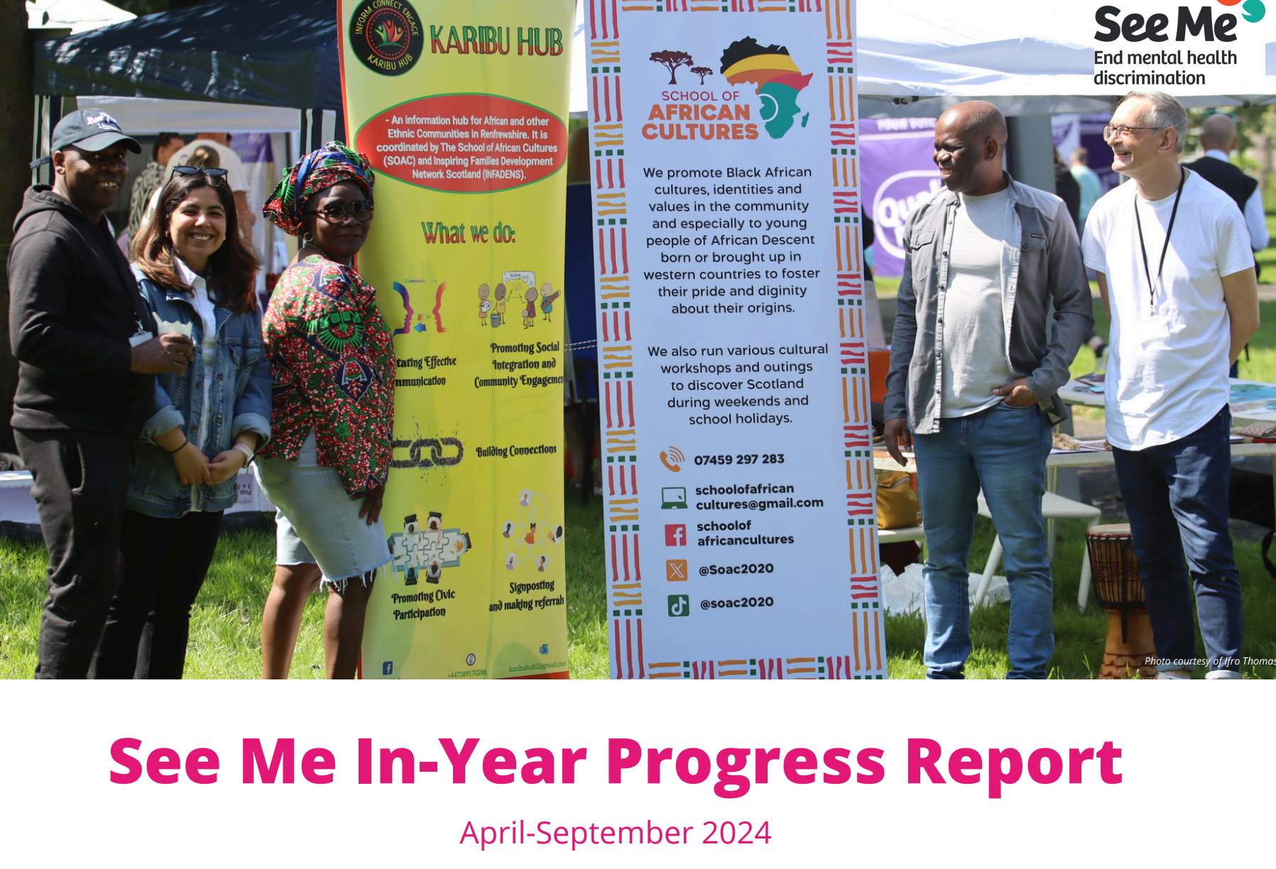
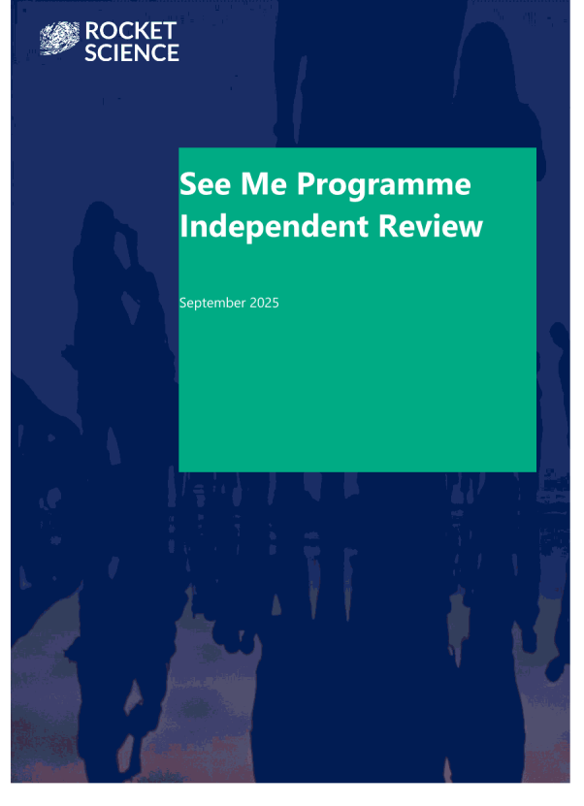

Added value of See Me – the national programme to end Mental Health Stigma and Discrimination

Slide 17
Proposed Mission / Vision going forward
Drive forward an intersectional approach to end mental health stigma and discrimination for all, for a fairer and more inclusive Scotland
Vision
Everyone experiences compassion, dignity and equitable mental health outcomes, with measurable reductions in stigma and discrimination in workplaces, mental and health care services, education and communities.

