Slide 1

Anti-Stigma Session: An Anti-Stigma Approach to Workplace Mental Health Inclusion
Bryony Mole (she/her) Project Officer for Workplaces

Slide 2

Safer space agreement and content warning
Keep yourself safe
Share only information that is yours to share – take time out if you need to.
Respect​
Everyone has different views and experiences. Treat people how you would like to be treated.​
Confidentiality​
What’s shared here by people shouldn’t be discussed outside.
Notes:
Safer space agreement and content warning
2MINS
Bryony
Due to the content of the workshop, we start by agreeing a Safer Space Agreement and Content Warning Notice.
The session will include descriptions of stigma and discrimination including stigmatising language and discriminatory practices across gender, race, sexuality, disability, and socio-economic deprivation. The session will also briefly touch on suicidal ideation and intent.
We agree to keep ourselves safe during this session - We will share only information that is ours to share – and please do take time out if you need to.
We will show respect for the fact that everyone has different views and experiences. And we'll treat people in the way that we would like to be treated.
We ask that student names and other staff members names are not included when discussing scenarios you have experienced and that all information provided to you by students about their mental health is anonymous within this session.
And finally, we agree to respect confidentiality with the understanding that what is shared here by people shouldn’t be discussed outside of this session.
Is everyone happy to agree to this?

Slide 3


See Me's Purpose
A Scotland where people can get the right help at the right time, expect recovery, and fully enjoy their rights, free from stigma and discrimination.
Change behaviours, cultures and systems.
People with experience of mental health problems are respected, valued and empowered​ to achieve the outcomes important to them.
Notes:
Bryony
2 minutes

Slide 4

What is stigma and discrimination in the context of mental health?
Stigma - a social process that involves the damaging labelling, stereotyping, and exclusion of individuals or groups based on perceived differences that deviate from dominant social norms.
Discrimination - a key part of stigma. It is the inequitable or prejudicial treatment of individuals or groups based on their stigmatised identities. It can be intentional (explicit prejudice) and unintentional (underlying in organisations and systems).
Intersectional stigma - multiple forms of stigma mutually shape the lived experiences and opportunities of groups who are marginalised, and create distinct disadvantages, which cannot be understood in isolation from one another.
Notes:
Bryony
2 minutes

Slide 5
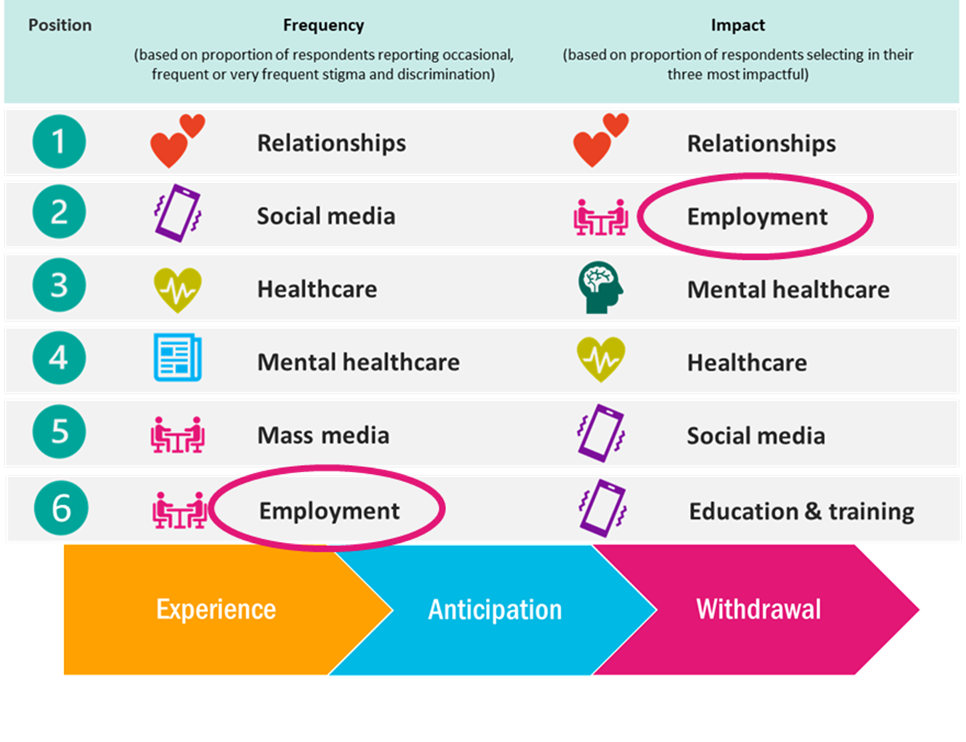

Data from the Scottish Mental Illness Stigma Study…
Notes:
2 minutes People who identify as living with mental illness continue to be stigmatised and discriminated in 14 areas of their life

Slide 6

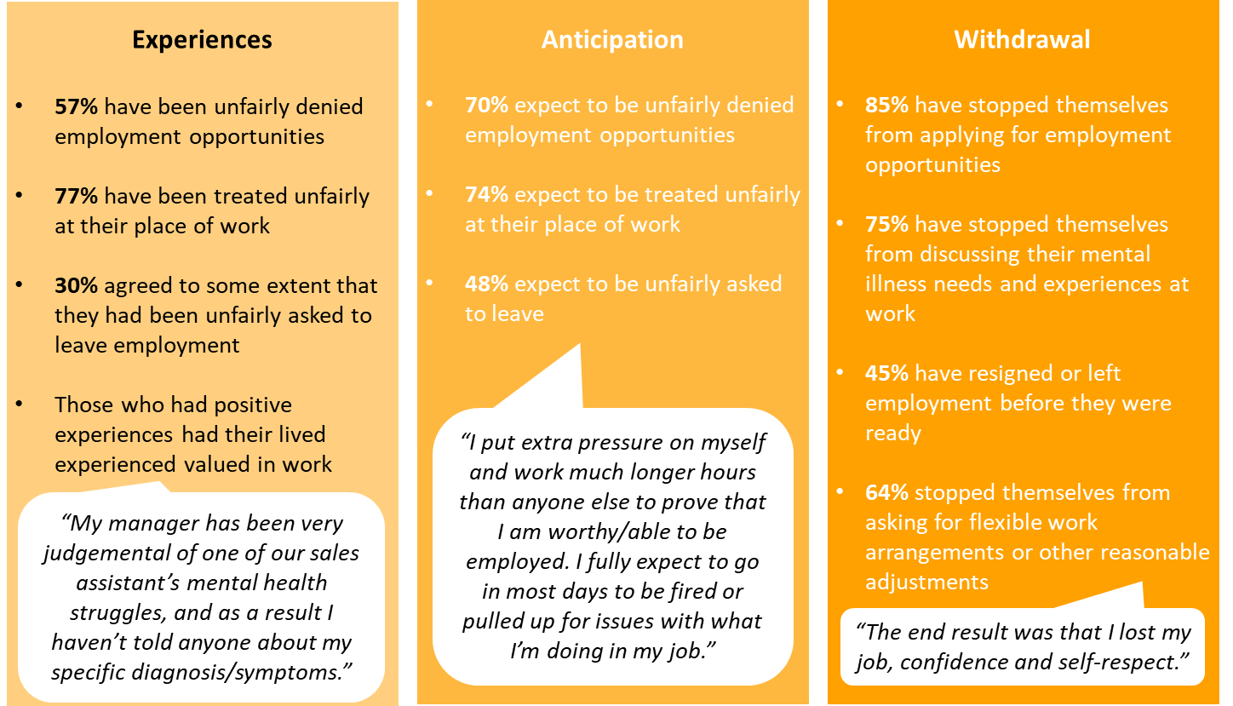
Employment
Notes:
Read:
Nearly three quarters (71 per cent), have experience stigma and discrimination around employment.
24% of respondents with personality disorder selected ‘employment’.
People with mental illness find themselves out of work as a direct result of stigma and discrimination.
57% have been unfairly denied employment opportunities
48% expect to be unfairly asked to leave
Of those who experienced stigma, 85 per cent have stopped themselves from applying for jobs, while nearly half have left work due to stigma and discrimination.
MH stigma has been found to be most prevalent and impactful in relationships within families and friendships, and the impact of intersecting experiences of stigmatising attitudes and discrimination that are compounded in work, even if these take place outside work? We know that LGBTQIA+ and racialised and marginalised communities experience higher levels of mental health problems/illness so how inclusive are employers making their working environments so that all employees can speak about their mental health needs and ask for help/support when they need it?

Slide 7
How does stigma operate?
Judgements and Perceptions​
Less than human, deserving of low status, personal failure
Stigmatising Terms (SMISS 2022)
Ignorant, Not intelligent​
Lazy
Undermined intelligence, worthiness, and agency
Expectations to be "productive"
Attention seeking​
Manipulative
Infantilising
Invalidates our experiences​​
Questions our ability to participate in decision-making​​
Dangerous, Deranged, Chaotic, Illogical, Unstable, Unpredictabile​
Hostile, Non-compliant
Hysterical
Instilling fear and threat​
Out of social control
Notes:
4MINS
The terms noted here have been reported through lived experience contributions to SMISS (2022).
These terms reveal the judgements and perceptions levied against people and the intentions of the stigmatisation.
•All of these terms position people as less than human, deserving of low status and being unworthy humans.
•And all of them feed into victim blaming – this attributes our mental ill health as personal failure rather than a result of genetic, medical or psychological issues.
Further, victim-blaming aims to mask systemic inequality as both a cause and consequence of MH issues.
•Terms such as ignorant and not intelligent – denote judgements that undermine our intelligence, our worthiness, and our agency.
•Lazy – Which denote the social expectations on us to productive – meaning to 'help ourselves', to 'get over it'.
•Accusations of attention seeking – question and invalidate our experiences and their severity.
•Stigmatising terms such as being deemed 'incapable' denote ideas that are infantilising and draw into question our ability to managing our own lives, and to participate in decision-making that impacts us.
•Dangerous, Deranged, Chaotic, Illogical, Unstable - Which denote ideas of fear, threat, and unpredictability.
•Hostile, Non-compliant – Denote ideas of people being out of social control in services and wider society.
•Some of these stigmatising terms such as “dangerous” are more readily applied to black men, or working class people, people who use substances.
•We are aware that stigma and discrimination relating to mental ill health are gendered, racialised, and they are compounded by our sexualities, and our disabilities. The term ‘Hysterical' and the misinformed "diagnoses" of hysteria was the first mental illness historically attributed solely to women – and dates back to Ancient Greece. Homosexuality was considered a mental illness into the 1970s. Being transgender was understood by the World Health organisation (WHO) as a mental health condition until 2019. And stark racial disparities in schizophrenia diagnoses have proliferated since the 19th Century. Unfortunately some of these stigmatising judgements and perceptions endure.

Slide 8

What impact does mental health stigma and discrimination have?
People who have faced stigma and discrimination are less likely to seek support from mental health services or access workplace mental health support
People who have faced stigma and discrimination often discuss not wanting to disclose their mental illness to friends and family members
People who have faced stigma and discrimination are less likely to reach out for support before reaching a crisis point
Are more likely to feel hesitation when applying for new jobs out of fear of future experiences of discrimination
Public stigma can become internalised into self-stigma where people believe the negative messages about mental illness which has a severe impact on their self-worth
Despite this impact we have found that many organisations mental health improvement and inclusion plans do not explicitly have any mention of how to reduce stigma and discrimination
Notes:
4 minutes

Slide 9

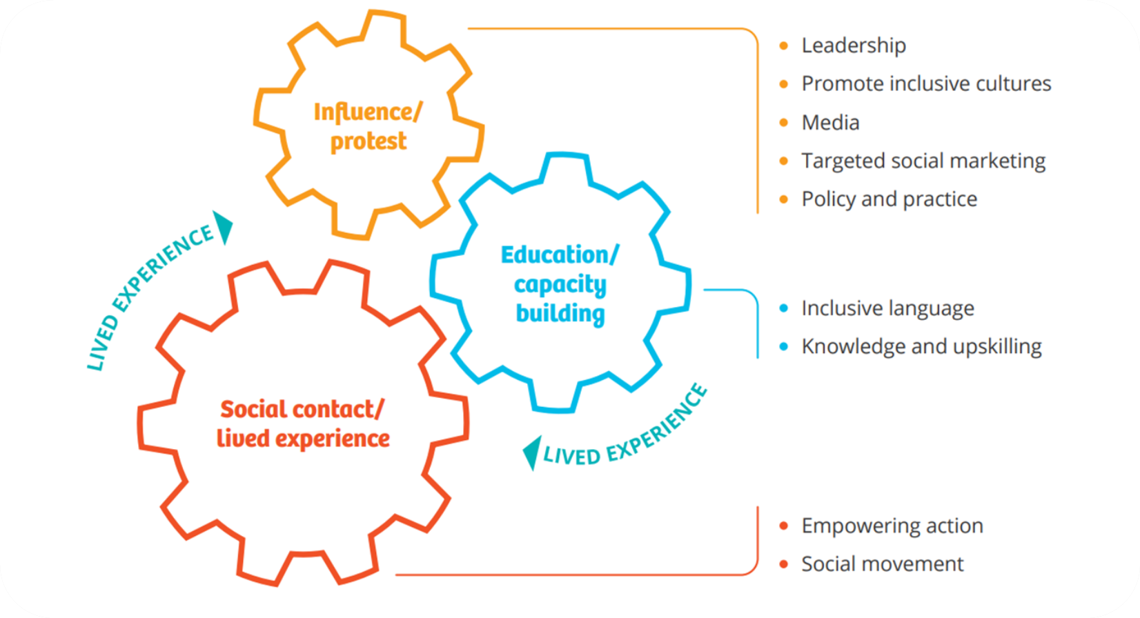
How do we stop stigma?

Slide 10

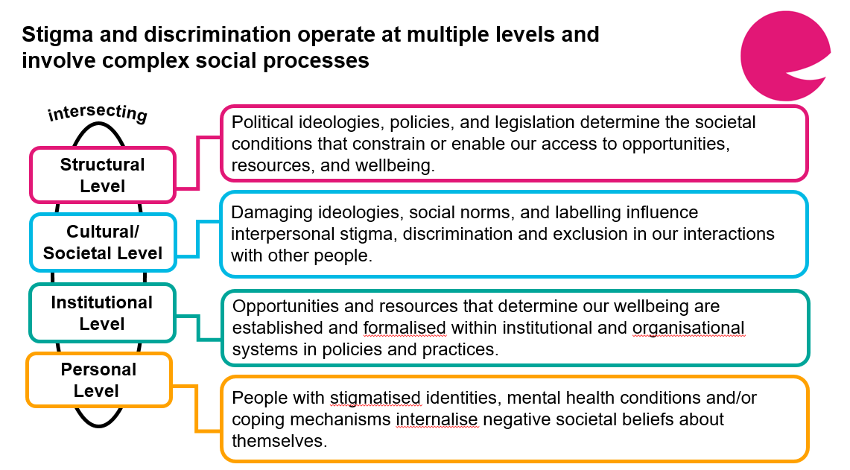
Whole organisational approach (SCIP)
Notes:
Wendy
The formation of mental health stigma and discrimination is a complex process occurring at multiple different levels. Our solutions to this must also occur at different levels. We cannot just consider action on just a personal level. Whilst this is important, as leaders within organisations we must consider what inclusion means at all of these levels as we have power to enact change.
2 minutes

Slide 11
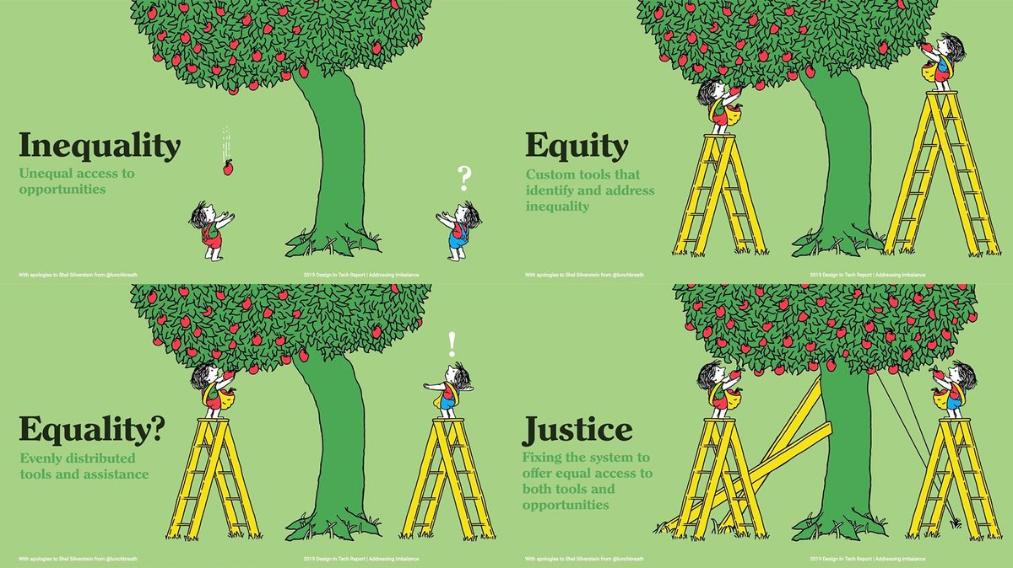
Equality vs Equity and Justice
Notes:
Equity and Justice need to work in tandem
Need to treat mental health like we would physical health

Slide 12
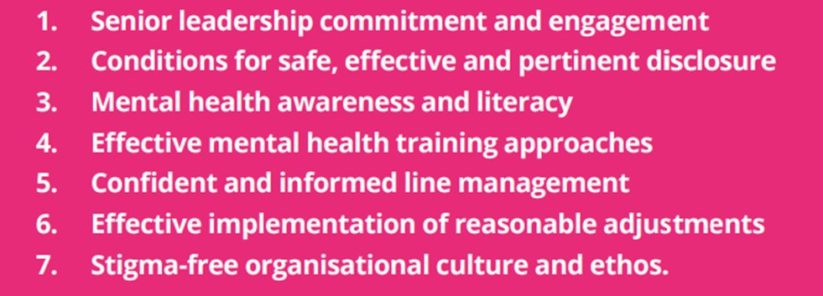
What does a workplace that is inclusive of mental health look like and feel like?
We have found that for workplaces to have an anti-stigma approach to mental health inclusion they should focus on these 7 key areas.
Organisations should aim to identify what they are already doing in these areas and where there are gaps that could be addressed. This should where possible be informed by feedback from employees with lived experience.
Notes:
Before showing the content have a discussion about what this looks and feels like for people , sharing ideas before discussing the building blocks and where organisations should focus on – 5 minutes – Bryony
Then talk through the 7 building blocks that would create an inclusive working environment for people with mental illness
5 minutes

Slide 13
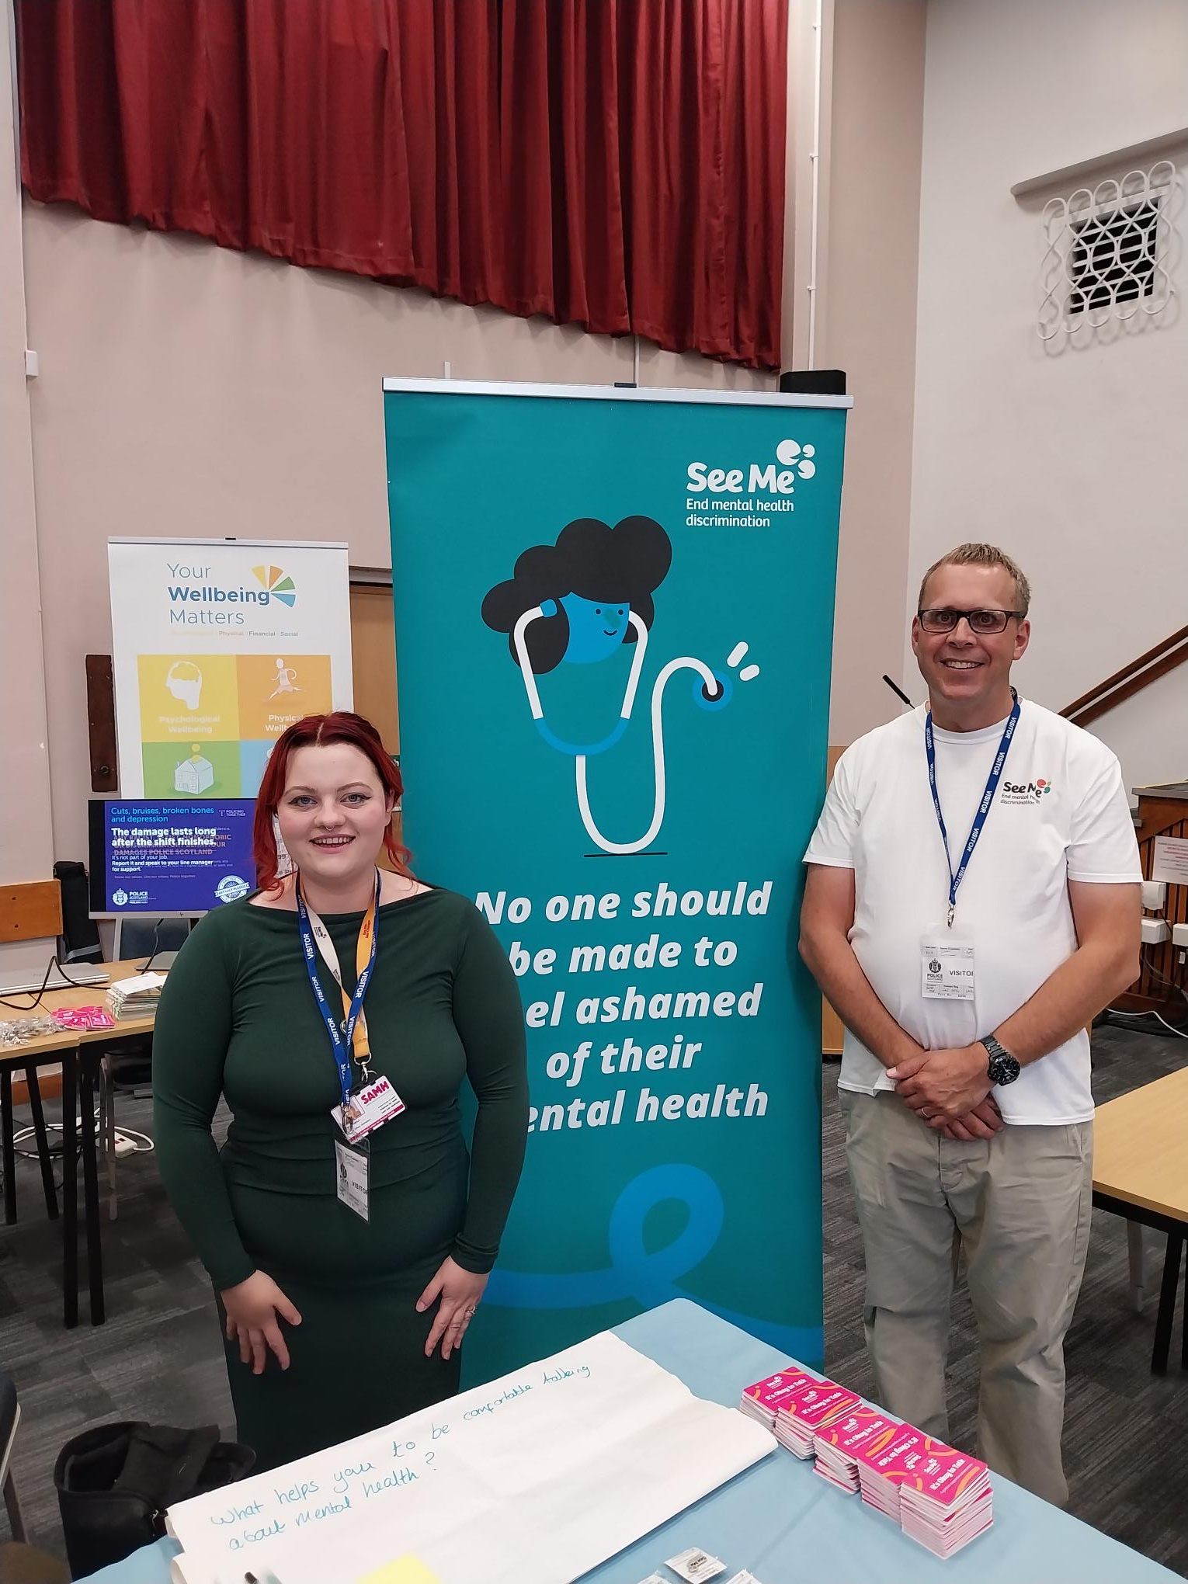
Lived Experience Input
See Me Volunteer
Gary Gilfillan (he/him)
Notes:
25 minutes

Slide 14
Personal Level Actions
Consider the language you use around mental health, lead with curiosity rather than assumption
Challenge stigmatising language when it happens (when safe to do so)
Engage in content and media that is led by lived experience
Engage with and advocate for mental health training opportunities
Highlight where policies and practices are putting in barriers to accessing support
Where safe to do so, openly share lived experience of mental health
Model supportive conversations

Slide 15
Institutional/Cultural Level Actions
Provide training to all staff on mental health literacy and find trainings that are guided by and contain the voice of lived experience
Have dedicated time to discuss with managers how they manage conversations about mental health and reasonable adjustments and provide dedicated training on having open conversations if this is an area where there is a need for development
Have proactive methods that support discussions about mental health such as wellness action plans for all staff, including management

Slide 16
Institutional/Cultural Level Actions
Regularly review your practices and policies that directly relate to mental health such as absence policies, return to work policies, reasonable adjustment procedures and get feedback on these processes from employees within the organisations
Work directly with mental health and disability advocates and charities on reviewing these procedures to identify where there may be barriers to accessing support and disclosure
Ensure reducing stigma is a meaningful and measurable part of your organisational wellbeing strategy
Share lived experience widely within your organisation and give regular reminders about where people can access and seek support
Have a proactive strategy not just a reactive response
Notes:
2 minutes – encourage people in the chat to write down what is one action they could realistically take to reduce stigma within their organisation or what is one think you are committing to do from today.

Slide 17
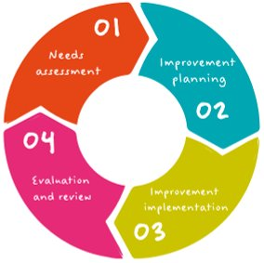
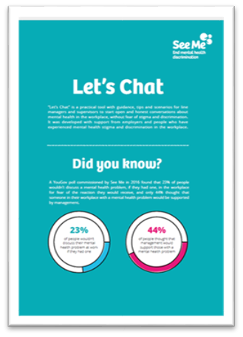
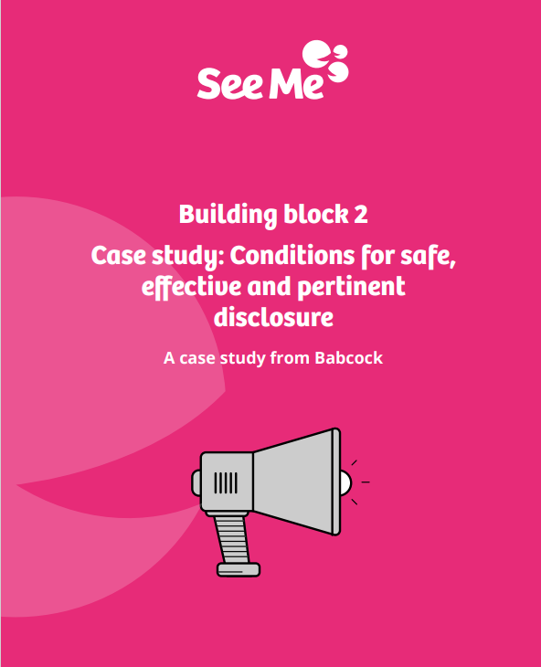
See Me in Work Programme
See Me in Work support employers to create the conditions for working environments that are inclusive of mental health, and free from stigma and discrimination through a free 4 stage self-directed programme. This programme focuses on:
Assessing the needs of the organisations and employees within the organisation in relation to mental health stigma and discrimination
Supports the creation of an improvement plan with recommended actions
Support your action implementation through consultation support calls and sharing resources
Evaluating the impact of this work on the organisations and identifying next steps for continued development

Slide 18
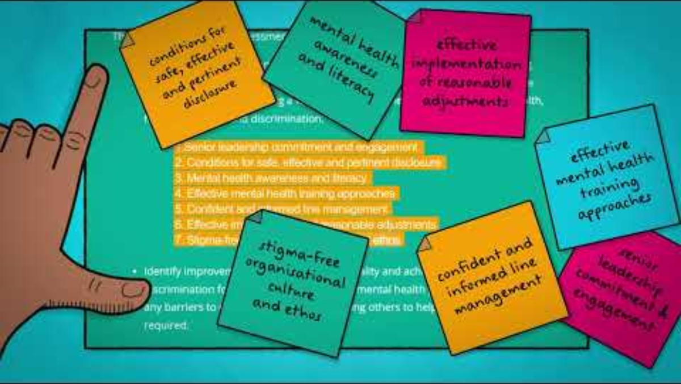
See Me in Work Programme

Slide 19
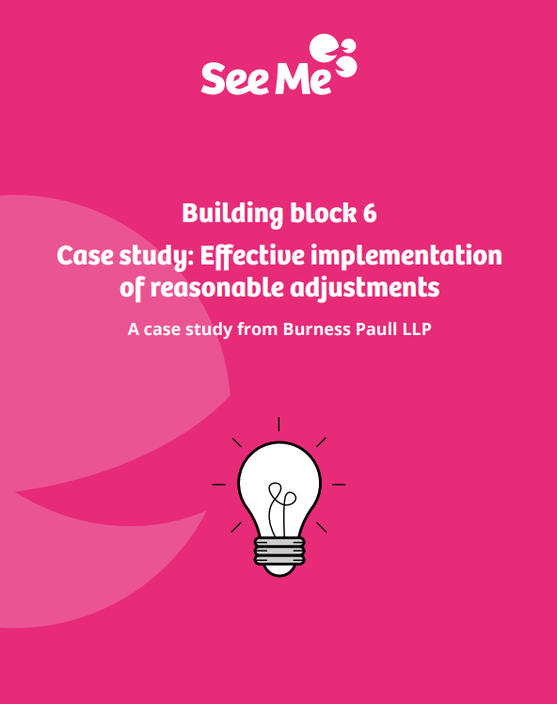
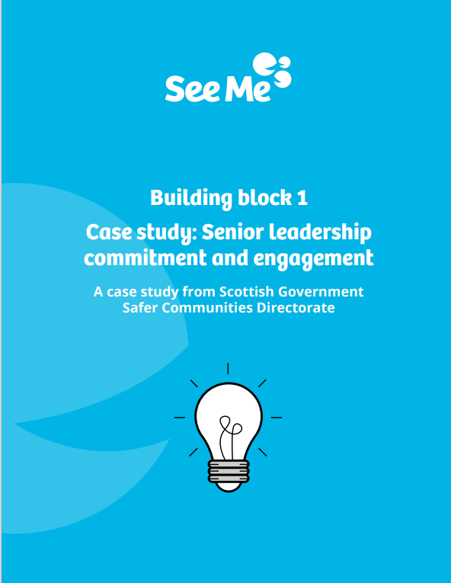
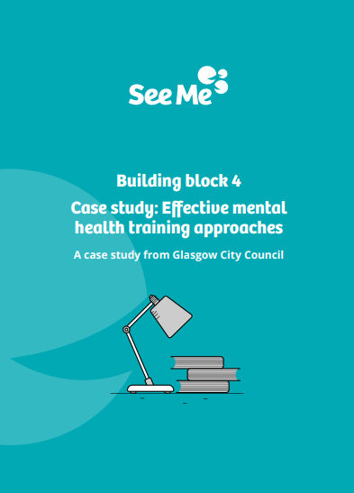
Employer Case Studies

Slide 20

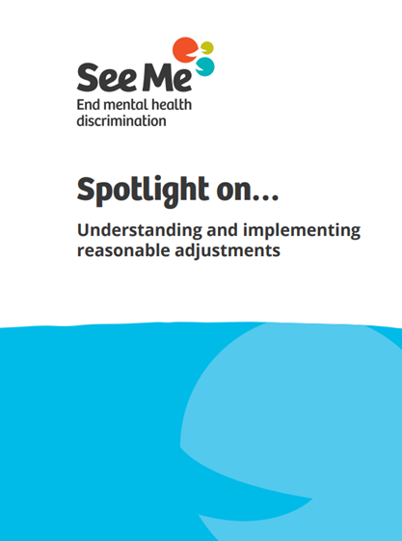

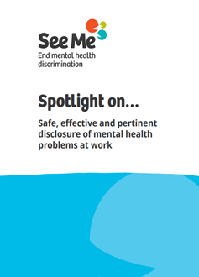

Resources to support
Notes:
Spotlight On Resources
E-Learning
Its Okay to Talk Cards
Let's Chat Tool

Slide 21

Workplace Resources: https://www.seemescotland.org/workplace/request-resources/
Email:
seemeworkplace@seemescotland.org

