Slide 1

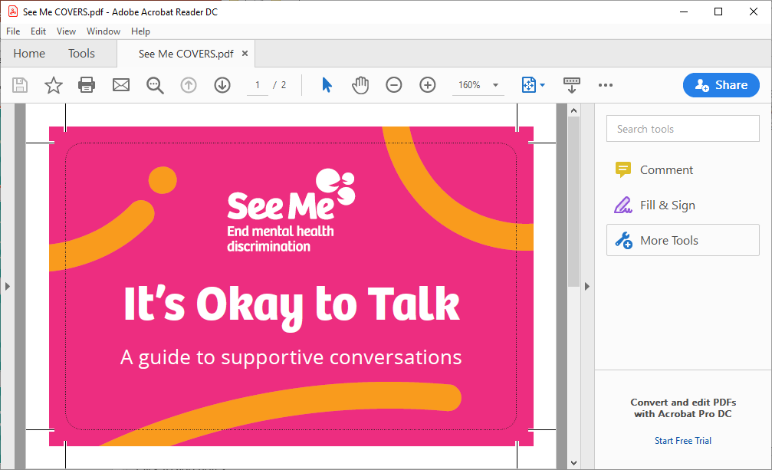

It’s Okay to Talk
How to have supportive conversations workshop

Slide 2
Session Objectives
Introduce the concepts of mental health stigma and discrimination and build the understanding of what stigma and discrimination is.
Develop a greater awareness of the impact of mental health stigma and discrimination.
Feel more confident to have a conversation about mental health – whether your own or with someone else.

Slide 3
Safer space agreement
Listen to each other.
Only share information you are comfortable sharing.
Respect other people’s limits and boundaries of confidentiality. Ideas are for sharing, personal stories are for honouring.
Think about the impact of our words, assumptions and actions upon others.
Respect the cultural and religious beliefs of others within the group.
If you need to take time out, a range of support within the session available to you.

Slide 4

Who, what & why
Who are you?
What do you do? (Student? staff member/ society member.)
Why are you here today?

Slide 5
Why challenge stigma?

Slide 6
Stigma & Discrimination
How would you define mental health stigma?
Stigma around mental health is about the negative attitudes or beliefs based on a preconception, misunderstanding or fear of someone with a mental health problem.

Slide 7
Stigma & Discrimination
How would you define mental health discrimination?
Discrimination is when a person performs an action, whether intentional or unintentional, that creates barriers and inequality for people with lived experience of mental health problems.

Slide 8
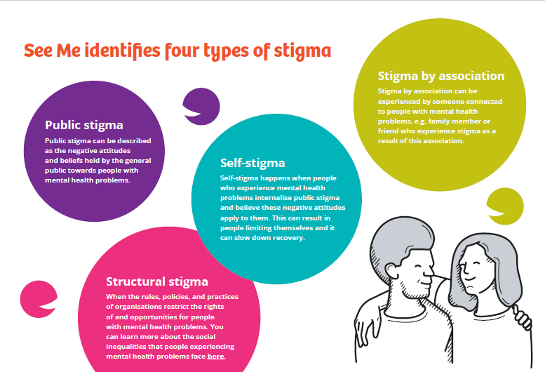

Slide 9
“No idea why anyone would believe that Amber Heard when she’s got loads of personality disorders.”
Public stigma
“I don’t want to be a burden, not sure anyone would think I had a real problem anyway so I’d better just keep quiet.”
Self-Stigma
“I attempted to get life insurance and it was just after I had been diagnosed with complex PTSD and I was refused life insurance, no one would insure me.”
Structural stigma
“They said I was unreliable because I had to care for my brother who is unwell at the minute.”
Stigma by Association

Slide 10
Other ways people may talk
about feeling stigmatised
Ashamed
Hopeless
Isolated
Inferior
Embarrassed
Belittled
Scared
Rejected
Lonely
Shunned
Anxious
Labelled/stereotyped
Persecuted/Oppressed
Dismissed
Ridiculed

Slide 11
On a scale of 1-5, how confident are you having a conversation about someone else’s mental health?

Slide 12
On a scale of 1-5, how confident are you having a conversation about your mental health with someone

Slide 13


Slide 14
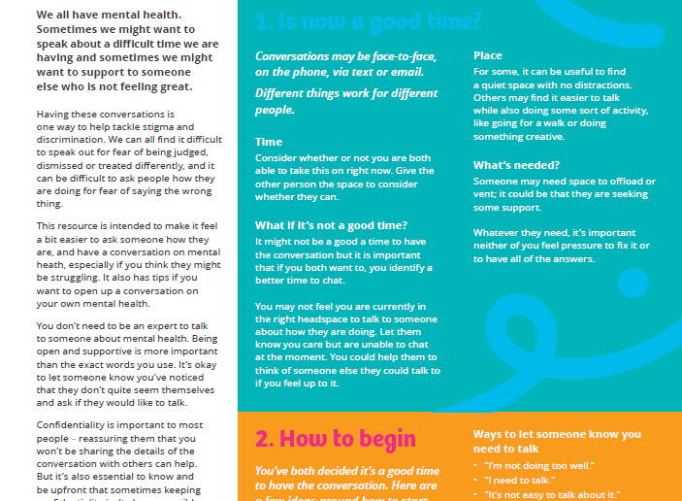

Slide 15
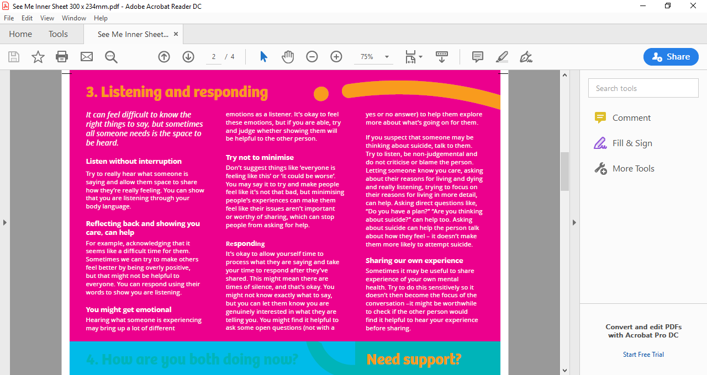

Slide 16
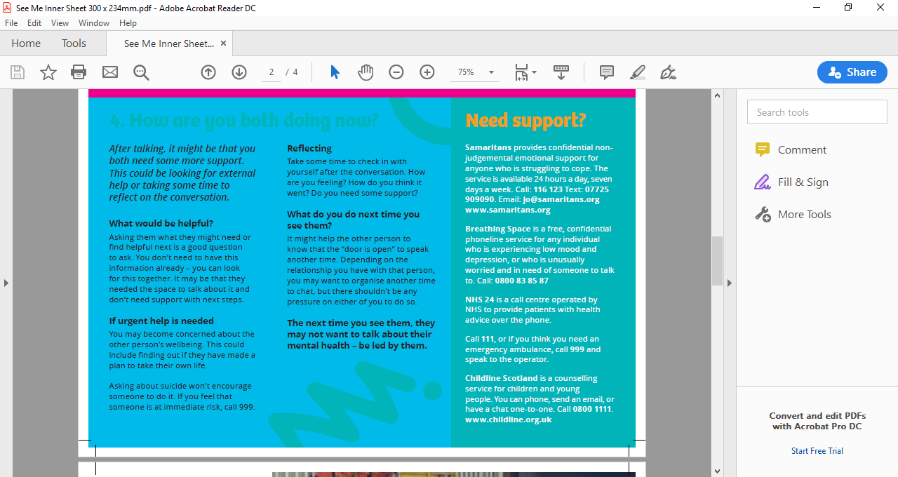

Slide 17
Is now a good time?

Slide 18

Scenario 1:
You’ve been at work and a colleague approaches you and asks if they can talk.
They tell you they’ve been struggling recently. You have also been having a difficult time of late and have another meeting that day that you are worried about getting to on time.

Slide 19
Scenario 2:
You’re at a friend’s birthday party and another friend starts chatting to you about how they’ve been struggling with their mental health of late.
It is very noisy and there are a lot of other people around you.

Slide 20
Scenario 3:
You are in the club house after training on a Thursday waiting for the meal to arrive. It is noisy and a lot of people are chatting at once.
The team aren’t in great spirits after losing a game at the weekend and some seemed visibly frustrated during the training session. Everyone is hungry and waiting for food to arrive.

Slide 21
Scenario 4:
You are waiting at a bus stop when a friend arrives to catch the same bus. They seem tearful and upset and ask if you have time to talk.
You are on your way to an appointment in town that you feel anxious about.

Slide 22
Scenario 5:
Your teenage daughter has been very quiet and withdrawn recently. One morning before school she asks if she can talk to you about how she is feeling.
You are trying to get your other child ready for school and make breakfast for the family.

Slide 23
Things to think about:
Time
Consider whether or not you are both able to have this conversation now.
Give the other person the space to consider whether they can.
What if it’s not a good time?
You might not feel you are currently in the right headspace to talk to someone about how they are doing. Let them know you care but are unable to chat at the moment.
You could identify a better time to chat.
You could also help them to think of someone else they could talk to if you feel up to it.

Slide 24
Things to think about:
Place
For some it can be useful to find a quiet space with no distractions.
Others might find it easier to talk while also doing some sort of activity like going for a walk or doing something creative.
What’s needed?
Someone may need space to offload or vent; it could be that they are seeking some support.
Whatever they need, it’s important that neither of you feels pressure to fix it or to have all the answers.

Slide 25

Take a 10 minute break

Slide 26

How to begin

Slide 27
How to begin
Ways to ask if someone is okay:
“How are you doing?”
“How have you been feeling?”
“I’m here if you want to chat.”
“How’s everything going?”
Ways to let someone know you need to talk:
“I’m not doing too well.”
“I need to talk.”
“It’s not easy to talk about it.”
“I trust you.”
“Do you have some time to chat?”

Slide 28
Listening and responding
What do you think can help?

Slide 29
Listening and responding
You don’t need to be an expert.
You don’t need to “fix” things.
It’s okay to have silence.
Be considered when sharing your own experience.
Reflect back what you are hearing can show you care.
Listen without interruption.
Try not to minimise.

Slide 30
Listening and responding practice
In small groups discuss the provided scenarios and consider:
How you use your body language.
How to encourage the other person while they are speaking.
What an appropriate response feels like.
What you might say.

Slide 31

How are you both now?

Slide 32
How are you both now?
What would be helpful?
Asking them what they might need or find helpful next is a good question to ask. You don’t need to have this information already – you can look for this together.
If urgent help is needed
You may become concerned about the other person’s wellbeing. This could include finding out if the have made a plan to take their own life. Asking someone about suicide won’t encourage someone to do it. If you feel that someone is at immediate risk, call 999.
Reflecting
You can both take some time to check in with yourself after the conversation.
What do you do next time you see them?
It might help the other person to know that the “door is open” to speak another time.
The next time you see them, they may not want to talk about their mental health – be led by them.

Slide 33

Support & Signposting
Breathing Space: www.breathingspace.scot
Samaritans: Phone 116 123 or self help app https://selfhelp.samaritans.org/
Black Minds Matter
www.blackmindsmatteruk.com
Saheliya
www.saheliya.co.uk
Shakti Women’s Aid
shaktiedinburgh.co.uk
LGBT Health & Wellbeing
www.lgbthealth.org.uk

Slide 34
Support & Signposting
Further Info and Resources:
See Me Website: www.seemescotland.org
SAMH Website: www.samh.org.uk
NHS 24: www.nhs24.scot
SAMH – Time for You – Online mental health support www.samh.org.uk/about-us/our-work/time-for-you

Slide 35
On a scale of 1-5, how confident are you having a conversation about someone else’s mental health?

Slide 36
On a scale of 1-5, how confident are you having a conversation about your mental health with someone

